Slide 1
8-BIT MULTIPLICATION
EXP NO: 3
AIM:To write an assembly language program to implement 8-bit multiplication using 8085 processor.
ALGORITHM: 1) Start the program by loading a register pair with the address of memory location. 2) Move the data to a register. 3) Get the second data and load it into the accumulator. 4) Add the two register contents. 5) Increment the value of the carry. 6) Check whether the repeated addition is over. 7) Store the value of product and the carry in the memory location. 8) Halt.
PROGRAM: LDA 8500 MOV B, A LDA 8501 MOV C, A CPI 00 JZ LOOP XRA A LOOP1: ADD B DCR C JZ LOOP JMP LOOP1 LOOP: STA 8502 RST 1

Slide 2
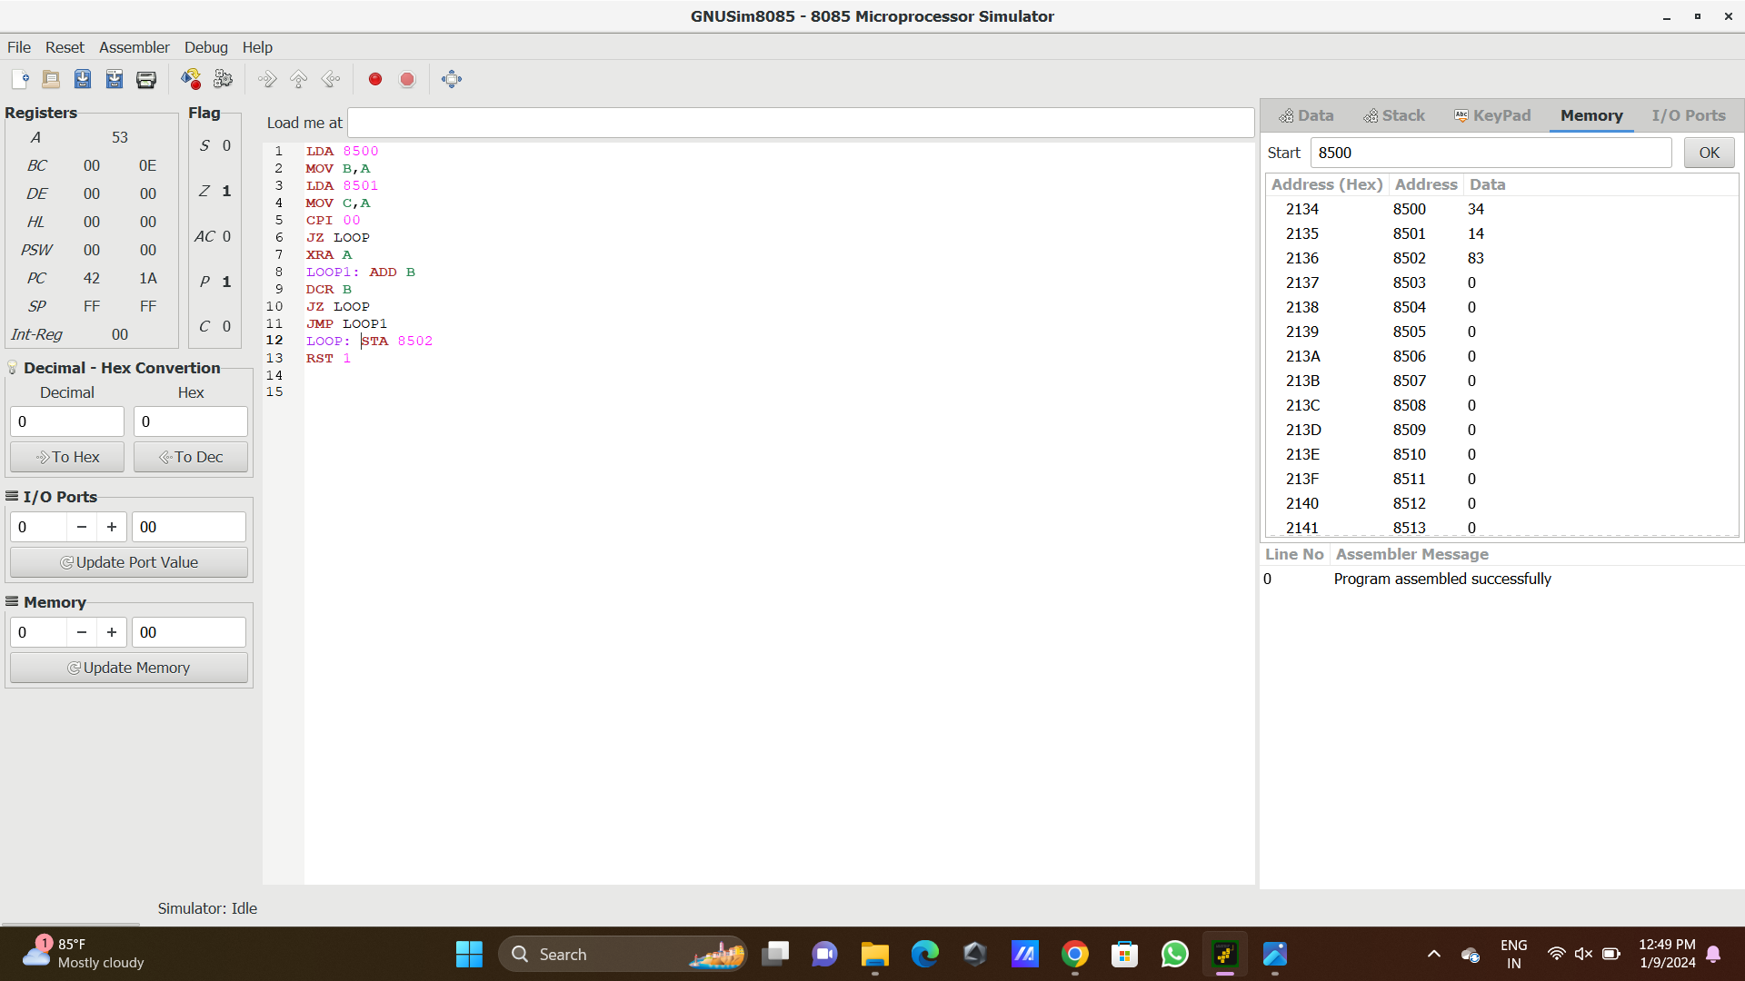
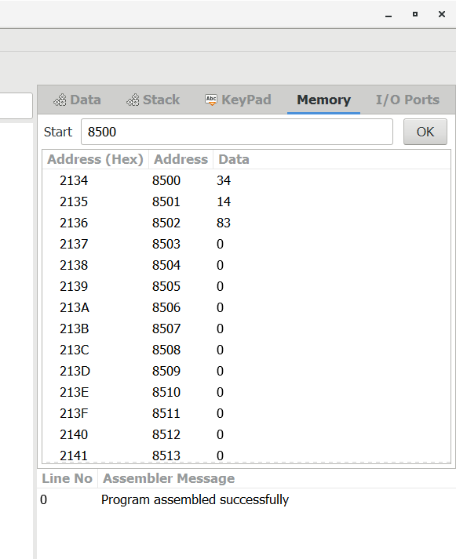
INPUT
OUTPUT

Slide 3
RESULT:Thus the program was executed successfully using 8085 processor simulator.

